Slide 1
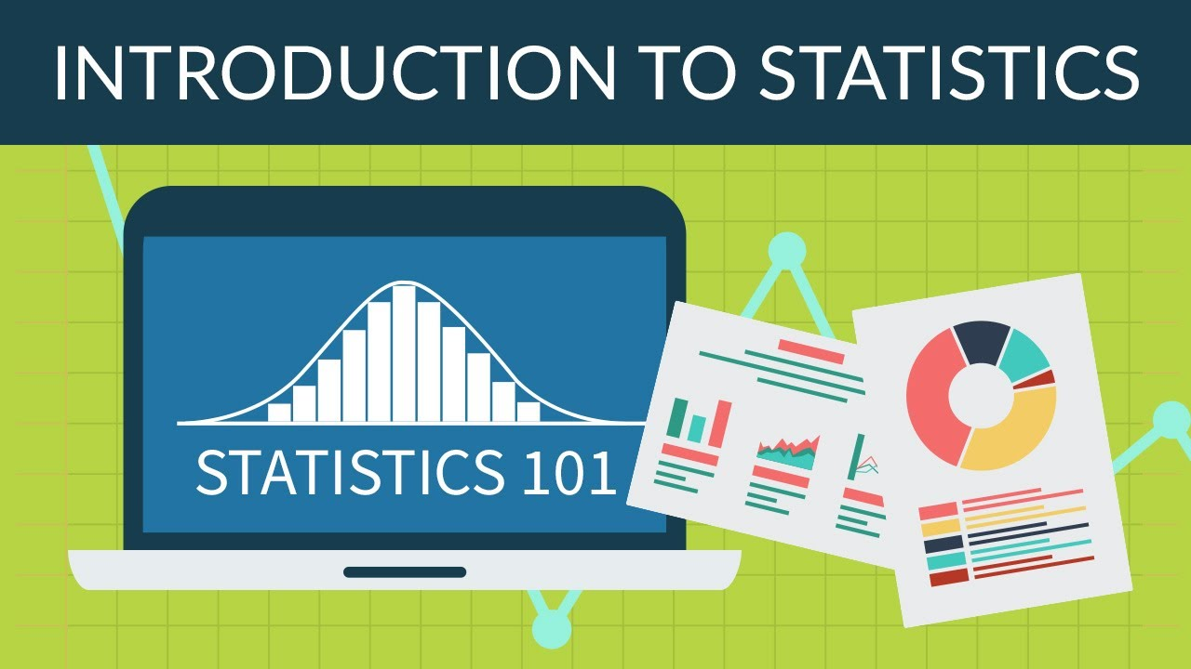
Unit IV (BTech CSBS)
Introduction to Statistics
Dr Jyoti Verma

Slide 2
What is Statistics?
• Statistics is a mathematical science, but it is not a branch of mathematics.
• Statistics is the science of data.
Statistics is a science that deals with the study of how to collect, classify, summarize, organize, analyze, interpret, and present data.
A branch of mathematics taking and transforming numbers into useful information for decision makers
Methods for processing & analyzing numbers
Methods for helping reduce the uncertainty inherent in decision making

Slide 3
Why study statistics?
Data are everywhere
Statistical techniques are used to make many decisions that affect our lives
No matter what your career, you will make professional decisions that involve data.
An understanding of statistical methods will help you make these decisions efectively
Statistics helps in providing a better understanding and exact description of a phenomenon of nature.
Statistics helps in proper and efficient planning of a statistical inquiry in any field of study.
Statistical helps in collecting an appropriate quantitative data.

Slide 4
Why study statistics?
Statistics helps in presenting complex data in a suitable tabular, diagrammatic and graphic form for an easy and clear comprehension of the data.
Statistics helps in understanding the nature and pattern of variability of a phenomenon through quantitative observations.
Statistics helps in drawing valid inference, along with a measure of their reliability about the population parameters from the sample data.
Draw conclusions about large groups of individuals or items, using information collected from subsets of the individuals or items.
Make reliable forecasts about a business activity
Improve business processes

Slide 5
Fields of Applications of Statistics
Actuarial science is the discipline that applies mathematical and statistical methods to assess risk in the insurance and finance industries.
Astrostatistics is the discipline that applies statistical analysis to the understanding of astronomical data.
Biostatistics is a branch of biology that studies biological phenomena and observations by means of statistical analysis, and includes medical statistics.
Business analytics is a rapidly developing business process that applies statistical methods to data sets (often very large) to develop new insights and understanding of business performance & opportunities
Chemometrics is the science of relating measurements made on a chemical system or process to the state of the system via application of mathematical or statistical methods.

Slide 6
Demography is the statistical study of all populations. It can be a very general science that can be applied to any kind of dynamic population, that is, one that changes over time or space.
Econometrics is a branch of economics that applies statistical methods to the empirical study of economic theories and relationships.
Environmental statistics is the application of statistical methods to environmental science. Weather, climate, air and water quality are included, as are studies of plant and animal populations.
Epidemiology is the study of factors affecting the health and illness of populations, and serves as the foundation and logic of interventions made in the interest of public health and preventive medicine.
Geostatistics is a branch of geography that deals with the analysis of data from disciplines such as petroleum geology, hydrogeology, hydrology, meteorology, oceanography, geochemistry, geography.

Slide 7
Operations research (or Operational Research) is an interdisciplinary branch of applied mathematics and formal science that uses methods such as mathematical modeling, statistics, and algorithms to arrive at optimal or near optimal solutions to complex problems.
Population ecology is a sub-field of ecology that deals with the dynamics of species populations and how these populations interact with the environment.
Psychometric is the theory and technique of educational and psychological measurement of knowledge, abilities, attitudes, and personality traits.
Quality control reviews the factors involved in manufacturing and production; it can make use of statistical sampling of product items to aid decisions in process control or in accepting deliveries.
Quantitative psychology is the science of statistically explaining and changing mental processes and behaviors in humans.

Slide 8
Reliability Engineering is the study of the ability of a system or component to perform its required functions under stated conditions for a specified period of time
Statistical finance, an area of econophysics, is an empirical attempt to shift finance from its normative roots to a positivist framework using exemplars from statistical physics with an emphasis on emergent or collective properties of financial markets.
Statistical mechanics is the application of probability theory, which includes mathematical tools for dealing with large populations, to the field of mechanics, which is concerned with the motion of particles or objects when subjected to a force.
Statistical physics is one of the fundamental theories of physics, and uses methods of probability theory in solving physical problems.
Statistical thermodynamics is the study of the microscopic behaviors of thermodynamic systems using probability theory and provides a molecular level interpretation of thermodynamic quantities such as work, heat, free energy, and entropy

Slide 9
Statistics
Descriptive Statistics
Inferential Statistics

Slide 10
Descriptive statistics:
The goal is to the organization, summarization, and presentation of data.
Inferential statistics:
The objective is to make reasonable guesses about population characteristics using sample data.
Average, spread, range, frequency, histogram, median, scatter plot, mode, interquartile range,…
Hypothesis test, z. ANOVA, confidence interval, ordinary least squares, 2, margin of error, t, …

Slide 11
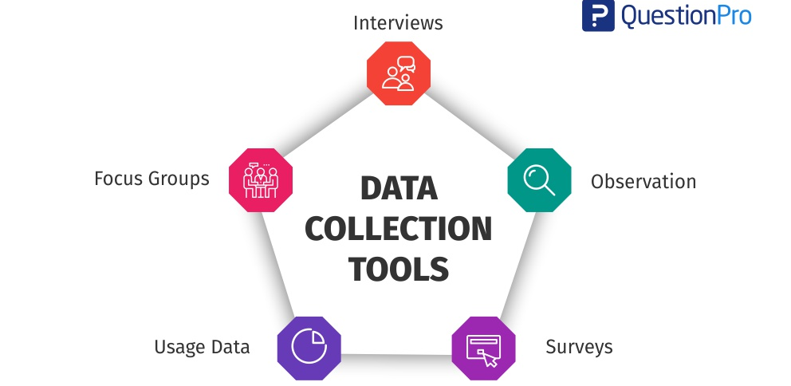
Data Collection
Data collection is a term used to describe a process of Systematic gathering of data for a particular purpose from various sources, that has been systematically observed, recorded, organized

Slide 12
PURPOSE OF DATA COLLECTION
To obtain information
To keep on record
To make decisions about important issues,
To pass information on to others ➢For research study

Slide 13
Why Collect Data?
A marketing research analyst needs to assess the effectiveness of a new television advertisement.
A pharmaceutical manufacturer needs to determine whether a new drug is more effective than those currently in use.
An operations manager wants to monitor a manufacturing process to find out whether the quality of the product being manufactured is conforming to company standards.
An auditor wants to review the financial transactions of a company in order to determine whether the company is in compliance with generally accepted accounting principles.

Slide 14
Methods of Data Collection
In an observational study, a researcher observes and measures characteristics of interest of part of a population.
In an experiment, a treatment is applied to part of a population, and responses are observed.
A simulation is the use of a mathematical or physical model to reproduce the conditions of a situation or process.
A survey is an investigation of one or more characteristics of a population.
A census is a measurement of an entire population.
A sampling is a measurement of part of a population.

Slide 15
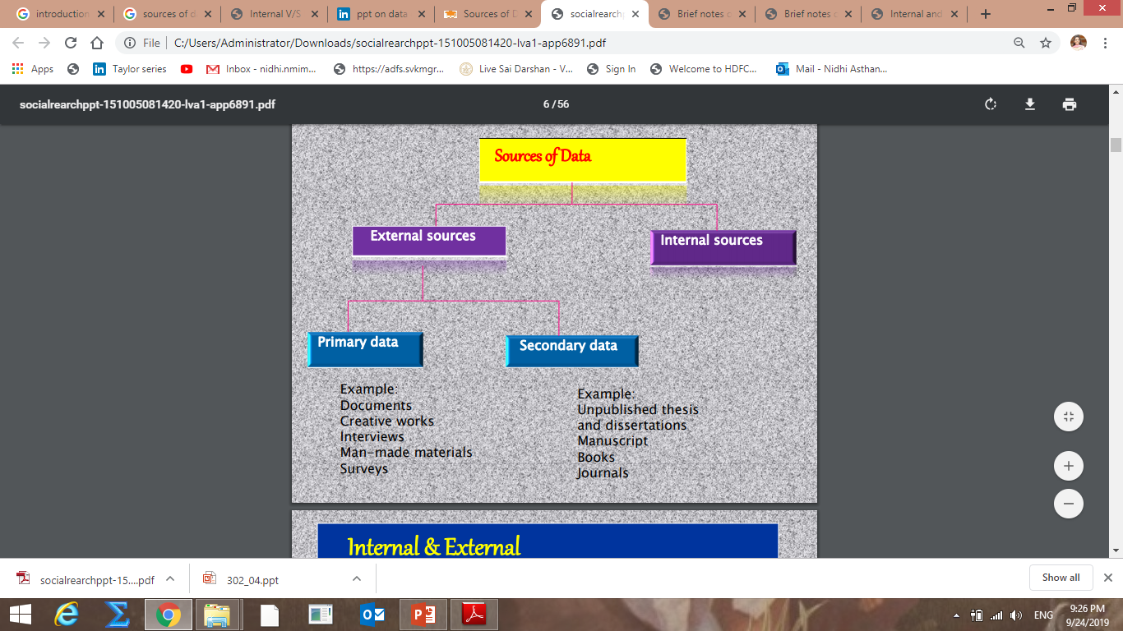

Slide 16
Internal Sources:
Internal sources of data are those which are obtained from the internal reports of an organization.
For instance, a factory publishes its annual report on total production, total profit and loss, total sales, loans, wages to employees, bonus and other facilities to employees etc.
Internal sources of Data
Many institutions and departments have information about their regular functions , for their own internal purposes
When those information are used in any survey is called internal sources of data.
Eg…social welfare socities.

Slide 17
External Sources
External sources refer to the information collected] outside agencies.
It can be collected from primary as well as secondary sources; type of information can be collected through census or sample method by conduct! Surveys and investigation.
When information is collected from outside agencies is called external sources of data. o Such types of data are either primary or secondary.
This type of information can be collected by census or sampling method by conducting survey.

Slide 18
Difference between Internal and External Sources
Meaning | Internal sourcesof data collection means data collected from the documents available with the company | External sources of data collection means the use of data published by external agencies.
Use of information | Information available from internal sources can be used directly for research purpose. Modifications are not required | Information available from external sources cannot be used directly as it is. Modifications as per the nature of research work are required.
Examples | Purchase records, sales records, periodical sales reports and annual reports are the examples of internal sources of data collection | Trade journals, annual reports of companies, surveys conducted by press, census reports etc. are examples of external sources of data collection.
Coverage | Limitedcoverage as they relate to company only. | Wide coverage as they are varied in character
Reliability | Internal sources are more reliable as they supply accurate data. Verification of data is not required | External sources may not supply accurate data. Naturally, a verification of data before actual use is necessary
Availability | Internal sources areeasily available and that too without any extra cost. | External sources arenot easily available Money is required to be spent on them.

Slide 19
Sources of Data
Primary Sources: The data collector is the one using the data for analysis
Data from a political survey
Data collected from an experiment
Observed data
Secondary Sources: The person performing data analysis is not the data collector
Analyzing census data
Examining data from print journals or data published on the internet.

Slide 20
Primary Data
Primary data are first hand information.
These information are collected directly from the source by means of field studies.
Primary data are original and are like raw materials. It is the most crude form of information.
The investigator himself collects primary data or supervises its collection. It may be collected on a sample or census basis or from case studies.

Slide 21
Merits
Demerits
Targeted issued are addressed
Evaluated cost
Data interpretation is better
Time consuming
More number of resources are required
High accuracy of data
Address as specific research issues
Inaccurate feedback
Greater control
Required lot of skill with labour

Slide 22
Secondary Data
Secondary data are the Second hand informations.
The data which have already been collected and processed by some agency or persons and are not used for the first time are termed as secondary data.
According to M. M. Blair, “Secondary data are those already in existence and which have been collected for some other purpose.”
Secondary data may be abstracted from existing records, published sources or unpublished sources.

Slide 23
EXAMPLE
Books
Journals/periodicals
Magazines/Newspapers
Published Electronic Sources
e-journals
General websites
Weblogs

Slide 24




















Merits
Demerits
Targeted issued are addressed
Evaluated cost
Data interpretation is better
Time consuming
High accuracy of data
More number of resources are required
Address as specific research
issues
Inaccurate feedback
Greater control
Required lot of skill with labour

Slide 25
Primary data
Secondary data
Real time data
Sure about sources of data
Past data
Not sure about of sources of data
Refining the problem
Cheap and no time consuming process
Can not know in data biasness or not
Less flexible
Help to give results/ finding
Costly and time consuming Process
Avoid biasness of response data More flexible

Slide 26
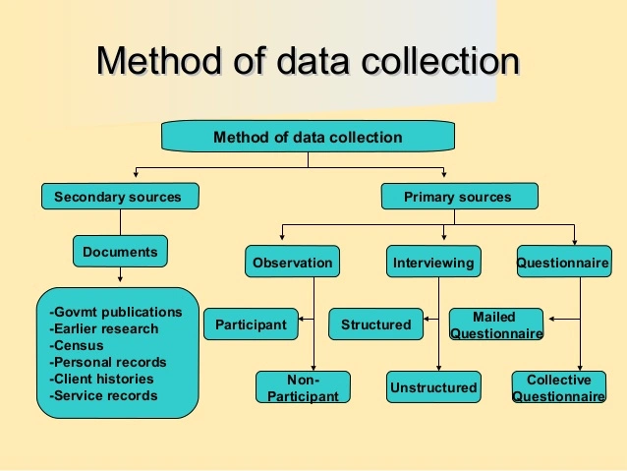

Slide 27
Population
Population is the entire group of individuals about which we want information (for example, all students at IUPUI).
A population includes all of the elements from a set of data.
Note: Population size is denoted by N.

Slide 28
Examples of Populations
Names of all registered voters in the United States
Incomes of all families living in Delhi
Annual returns of all stocks traded on the New York Stock Exchange
Grade point averages of all the students in your Institute

Slide 29
Sample
Sample is a representative part of the population(for example, a representative group of students at IUPUI).
A sample consists one or more observations drawn from the population.
Note: Sample size is denoted by n.

Slide 30
Population vs. Sample
Population
Sample
Measures used to describe the population are called parameters
Measures computed from sample data are called statistics

Slide 31
Unbiased sample: A sample that is selected so that it is representative of the entire population.
An unbiased sample is selected at random and is large enough to provide accurate data.
Biased sample: A sample drawn in such a way that one or more parts of the population are favored over others.

Slide 32

Example 1: A 7th grade homeroom was surveyed to determine how many texts students at Olean Intermediate Middle School send each day.
What is the population?
All students in the school
What is the sample?
Students in the seventh grade homeroom that was surveyed
Biased or unbiased?
Biased. One class of 7th graders does not accurately represent all students in the school.

Slide 33

Example 2: To track migration patterns of a particular species of bird, scientists randomly tag, release, and track 50 birds of that species.
What is the population?
The species of bird being studied
What is the sample?
The 50 birds that the scientists tagged
Tagged birds are specially marked birds that are tracked. Scientists use the data on these birds to make generalizations about an entire bird species.
Biased or unbiased?
Unbiased. The birds tagged were randomly selected.

Slide 34
Thank You

